Slide 1
Your Effect on Water
School/program name
Date

Slide 2
Background Information (for facilitator)
Humans live in the midst of many ecosystems, yet often behave as though their activities have no effect on these systems. Humans are very much connected to the natural world around them and are ultimately affected by every action they take that harms their environment. The harm may not be immediate in space or time, but hurting the environment will result in harmful consequences for humans at some point in the longer term. This is because all organisms—including humans—are interconnected. Anything that destroys the survivability of one organism in an ecosystem also threatens the other organisms in that ecosystem.
Pollutants can have drastic effects on ecosystems, and often it is the substances people find useful, such as fertilizers, that wreak the most havoc on the natural environment. Toxic substances, such as pesticides and oil spills, are well known as pollutants, and the harm they cause is well understood. Yet humans do not always consider the effect of residential and agricultural fertilizer runoff on local lakes and streams. Even the products used on lawns can negatively impact the environment. Excess fertilizer, washed into storm drains and carried to local lakes, can cause an overproduction of plant life, unbalancing the aquatic ecosystem and endangering its creatures.

Slide 3
Agenda
Opening (30 minutes)
Setting the Stage: Water Contamination Demonstration (30 minutes)
Cyber Investigation & Activity: Effects of Pollution on the Water Supply (60 minutes)
Setting the Stage: Human Impact on Water Quality (10 minutes)
Activity: Observing the Influence of Acid Rain on Plant Growth (45 minutes)
Break (15 minutes)
Cyber Investigation: Water Pollution Paperslides (50 minutes)
Lunch (30 minutes)
Recess: Water Balloon Battleship (30 minutes)
STEMtastic Careers (30 minutes)
Project: Fruit and Veggies Long Term Project (15 minutes)
Activity: The Shallows (45 minutes)
Mind Snacks (15 minutes)
Dive Into Digital Project (30 minutes)
STEMtastic Friday Celebration Preparation (30 minutes)
STEM Camp Notebook Reflection (30 minutes)
STEMtastic Friday Celebration with Parents (60 minutes)

Slide 4
Learning Objectives
To explain the effects of pollution on the water supply
To explore ways humans impact the water supply
To determine ways to conserve water

Slide 5
Today’s Vocabulary
Pollute

Slide 6
Setting the Stage
Water Contamination Demonstration

Slide 7
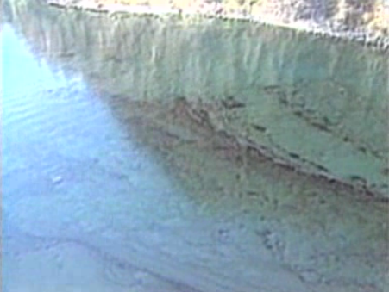
Cyber Investigation & Activity: Effects of Pollution on the Water Supply
Video: Oil Spills
Notes:
Before students watch the video have them create a T-chart. Have them label the left hand side of the chart, “Effects of Human Activity on Watershed” and the right-hand side of the chart “Possible Consequences.”
As the students watch the videos they should be looking for evidence that shows how human activity can affect the water supply locally, regionally, nationally and/or globally. Have students watch the video clips Source of Life: Water in Our Environment, Disaster in the Gulf, A Race against Time, and Our Wondrous Oceans: Planet Water. As students watch the video segments have them complete their T-charts.
After watching the video segments, have students work in pairs to create a model to show the effects of human activity on a watershed. In order to construct their model, students will use their T-charts and the materials in the list above to develop two models. After they have created their models, students present their models to the class in an adapted gallery walk. One student of each pair will stay by their model and present/explain their team’s model to other students who walk around. After 5 minutes, students will switch positions with their partners.

Slide 8
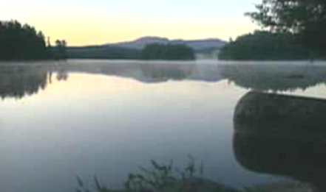
Setting the Stage: Human Impact on Water Quality
Video: Intro
Notes:
Begin the discussion with the following question: How do human activities impact the water supply? Students will bring up concepts that they have learned during the week.

Slide 9
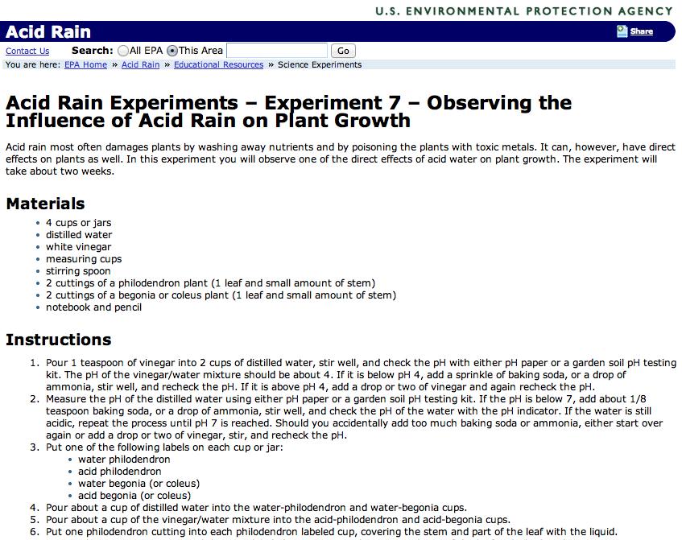
Activity: Observing the Influence of Acid Rain on Plant Growth
Notes:
Have students draw three columns in their STEM Camp Notebooks labeling each column K, W, L, respectively. Ask students to write down things they know about a watershed in the K column and things they wonder about a watershed in the W column. Instruct campers to fill in the W column with things they learn about watersheds as they do the activity. Solicit responses from students about what they wrote in the K or W of the chart. After the discussion, play the video segment, Watersheds, Estuaries, and Wetlands, pause and play in appropriate places as a result of earlier discussion allowing students to add facts to their L column. Then have students write a definition of watersheds in their own words in their STEM Camp Notebooks, asking them to include examples and nonexamples.
Have students read We All Live Downstream. Consider introducing one of these reading strategies to support comprehension. Encourage students to revise their definition of watershed in their STEM Camp Notebooks and also include their answers to the question: What does the saying “We all live downstream” mean to you?
Follow up by playing the video segment Water Pollution (5:32), pausing at critical points and prompting students to answer questions about main ideas.

Slide 10
Cyber Investigation & Activity: Water Pollution Paperslides
Interactive Video: Water, Pollution, and Waste
Notes:
In groups of two or three, students should create a paper slide video based on their summary frames. Students will use blank white paper and sketch a drawing for each summary frame. Emphasis should be placed on sketching and not creating artistic masterpieces. Students then will practice moving the slides with timing to the audio of the interactive video. Finally students will use phone cameras or video cameras to record a paper slide video.

Slide 11
STEMtastic Careers
Today’s career paths focus on pollution control careers. Have student read the job description and skills needed to succeed for Environmental Science and Protection Technicians.

Slide 12
Project: Fruit and Veggies
Notes:
Have students weigh their plates for the final time and record the data in their journals. Students then will calculate the amount of water in each fruit by percentage and amount.

Slide 13
Activity: The Shallows
Notes:
In this activity, students will develop movements that will coordinate with the song The Shallows by Lodge McCammon. Using the kinesthetic lectures, students will practice their movements and get prepared to present to parents that afternoon.

Slide 14
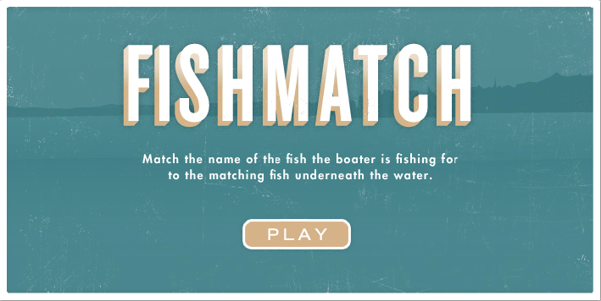
Mind Snacks

Slide 15
Dive into Digital Project
Notes:
Facilitators can decide whether to include this project as part of their daily curriculum, as an optional extension or decide not to use it at all.

Slide 16
STEMtastic Friday Celebration Preparation
Notes:
Setup and collect artifacts for the STEM Showcase. Practice choreography to The Shallows song.
You can have students showcase some or all of the following artifacts from the week:
Day 1 - butcher paper bodies
Day 2 - video of students singing Little Water Molecule song
Day 3 - terra aqua columns
Day 4 - water turbine

Slide 17
Notebook Reflection
How will you use your knowledge about water to make a difference in your home? School? Community?

Slide 18
STEMtastic Friday Celebration with Parents

