Slide 1
Urban Infrastructure and Earthquakes
School/program name
Date

Slide 2
Background Information (for facilitator)
Earthquakes are caused by the stress built up in rocks that make up the crust of the earth. As plates move along the mantle, they collide, move away from each other, and slide past each other at plate boundaries. These motions cause a build up of energy in the crust, and when the energy reaches a threshold, the energy is released as seismic waves or earthquakes. Earthquakes most frequently occur along plate boundaries.
There are three types of plate boundaries: convergent, divergent, and transform. At convergent plate boundaries, continental-continental or oceanic-continental plates move toward each other. An example of a well-known convergent boundary is the Himalayas, where the Indian Plate is colliding with the Eurasian Plate. Divergent plate boundaries describe plates that move away from each other. The most recognizable oceanic-oceanic divergent plate boundary is the Mid Atlantic Ocean Ridge, where the Eurasian Plate is moving away from the North American Plate. The San Andreas Fault in California is the site of a transform boundary, where two continental plates are moving in opposite directions of each other. Frequent earthquakes are a result of this active plate boundary.
Major earthquakes typically cause significant damage to infrastructure and property, including bridges, buildings, and homes. Engineers design structures to minimize the damage caused by earthquakes, particularly in areas where frequent earthquakes occur. When engineers design these structures, they consider materials that are both strong and flexible to withstand the swaying motion resulting from earthquakes.
People can take preventative measures to prepare for an earthquake by gathering and storing supplies and food. Immediately after an earthquake, grocery stores are often closed and food and medical supplies can be in short supply or unavailable. Learning CPR or First Aid or taking an emergency medical training course can help people better tend to those injured during the earthquake.
Although aftershocks and tremors are concerns for people after earthquakes, earthquake epicenters located near an ocean may also have to contend with potential tsunamis—tidal waves resulting from earthquakes that happen underwater. In such places, preventative measures are taken to minimize damage to cities, including buildings, homes and people. In densely populated areas, engineers may build artificial barriers to block out tsunami waves that approach coastlines.

Slide 3
Agenda
Opening (30 minutes)
Setting the Stage (45 minutes)
Activity: Introduce Building for an Earthquake (15 minutes)
Break (15 minutes)
Activity: Building for an Earthquake (45 minutes)
Activity: People Move (60 minutes)
Lunch (30 minutes)
Recess: Earthquake Block Building (30 minutes)
STEM-tastic Careers (20 minutes)
Dream School Engineering Challenge: Phase Three (55 minutes)
Mind Snacks (20 minutes)
Dream School Engineering Challenge: Phase Four (30 minutes)
STEM Camp Notebook Reflection (15 minutes)
Wrap Up (10 minutes)
Dive Into Digital Project (60 minutes)

Slide 4
Learning Objectives
To understand why certain areas are more prone to earthquakes
To understand how earthquakes damage urban areas
To understand how buildings and other structures can be designed to withstand earthquakes

Slide 5
Today’s Vocabulary
Earthquakes
Epicenter
Tectonic Plate

Slide 6
Setting the Stage

Slide 7
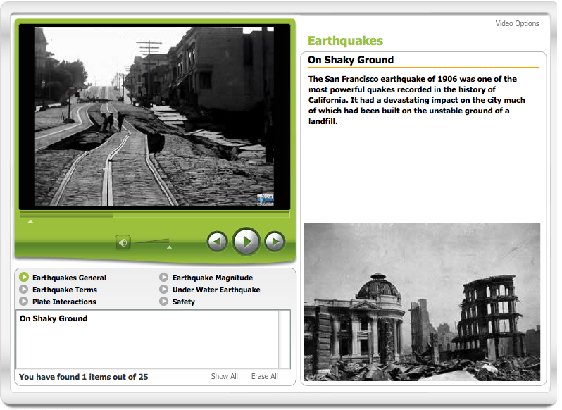
What causes an Earthquake?
Interactive Video: Earthquakes
Notes:
Tell students that today they will be investigating urban infrastructure, and how it is affected by earthquakes. As they deepen their understanding of earthquakes and other geological settings and phenomena they should consider the location of their Dream School and/or the preparations needed based on where they decide to build.
Share the Interactive Video Earthquakes with the students. Explain to students that Earth’s crust is broken into many different pieces called tectonic plates, and that these plates are in constant, albeit very slow motion. This motion, along with the interaction between different tectonic plates, is what causes earthquakes.

Slide 8
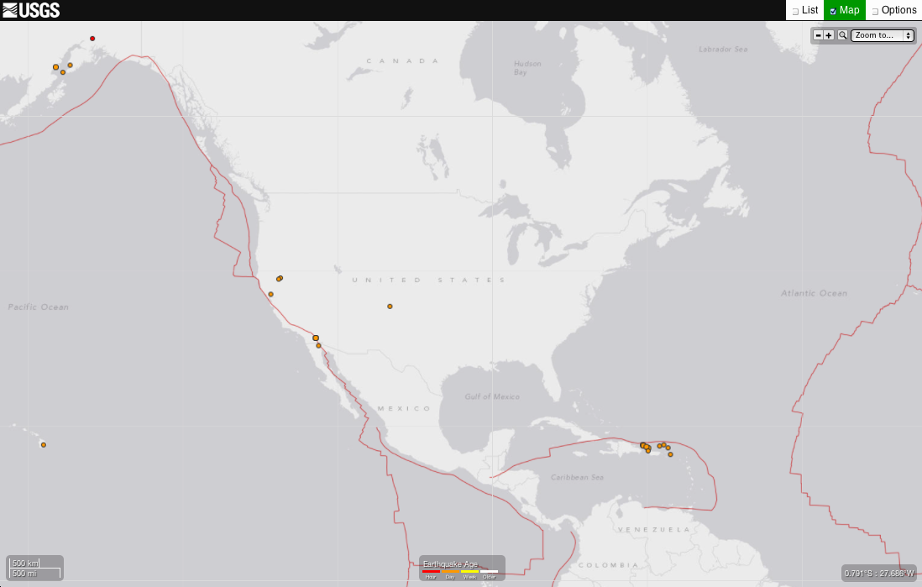
USGS Real-Time Earthquake Map
Notes:
Now, navigate to the USGS Real-Time Earthquake Map. Have students explore the map to see where recent earthquakes have occurred. Based on their locations, discuss whether any of these earthquakes may have affected major cities and if their proposed location for their Dream School might be impacted.

Slide 9
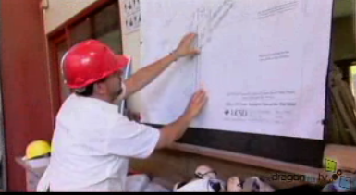
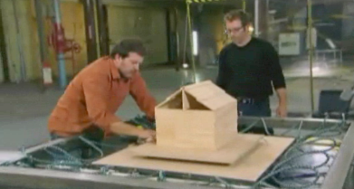
How do engineers design buildings to withstand an earthquake?
Video: Engineer Jose Rostrepo on Building Earthquake Resistant Buildings
Video: Full-Scale Tests
Notes:
Show one or more of these video segments to introduce students to some of the ways that engineers design buildings to withstand earthquakes. Ask the students why these designs are important.
Engineer Jose Rostrepo on Building Earthquake Resistant Buildings (1:38)
Full-Scale Tests (6.00)
4.0 Magnitude (5:04)

Slide 10
Activity: Building for an Earthquake
Notes:
Introduction: Students working in small groups (3 or 4 students per group) will be challenged to build a variety of structures out of different-sized blocks made of different materials (rigid craft foam, cardboard, wood). Their goal is to determine which combination of blocks produces the most stable structure and the least stable structure in a simulated “earthquake”. Each structure they test should contain exactly three blocks stacked one of top of the other.
Students should consider the following factors when designing their structures:
Weight distribution: Where is the heaviest block? Where is the lightest block?
Shape: Where is my building the widest? Where is it the narrowest?
Height: How tall is my building?
Follow the activity with a discussion about where the teams have decided to locate their Dream School. Are their schools in an area where they should design and build for earthquakes? Would they consider moving their location or decide to make the necessary adjustments to build for an earthquake?

Slide 11
Activity: People Move
Notes:
Location can be everything when it comes to infrastructure development. People move to different towns and cities for a variety of reasons. In this activity, students will develop movements that will coordinate with the song People Move by Lodge McCammon. Using the kinesthetic lectures students will practice their movements and get prepared to record their performance.
Have students listen to the song while reading the lyrics. Repeat as necessary. Then review the Kinesthetic Lectures associated with the song as a whole class in order to learn the content. Here is the full video for your reference. Break the class into five small groups, one group for each part of the song. Have each group perfect their part of the song using the following Kinesthetic Lectures as a guide.
People Move (whole song)
People Move – Verse 1
People Move – Verse 2
People Move - Chorus
People Move - Bridge
Students are strongly encouraged to be creative by adding to or changing their section of the song using different movements or props that further illustrate the song’s content.
Film it in one-take. Final videos should avoid transitions, digital effects, or editing in order to focus on the content the students have learned. Please make sure you have the appropriate permissions for all students who will appear on camera.

Slide 12
STEMtastic Careers

Slide 13
How do seismologists learn about earthquakes?
How can the research that seismologists do be used to improve urban infrastructure?
Video: Seismologist
Notes:
Explore the career of a seismologist. Show students the video segment Seismologist (4:17).
Use these prompts to discuss the video with the students:
How do seismologists learn about earthquakes?
How can the research that seismologists do be used to improve urban infrastructure?

Slide 14
Dream School Engineering Challenge: Phase Three
Notes:
Have students work on their Phase Three of their dream school design.

Slide 15
Mind Snacks
Notes:
Distribute snacks to the students while they interact with the exploration, How it shakes out.

Slide 16
Dream School Engineering Challenge: Phase Four
Notes:
Have students work on their Phase Four of their dream school design.

Slide 17
Notebook Reflection
Based on what have you learned about urban infrastructure and earthquakes, what measures is your team taking to make sure your school is safe?

Slide 18
Wrap Up

Slide 19
Think about this…
What other geologic factors do you think must be accounted for when designing urban infrastructure?
Notes:
As a precursor to Day 3, ask students the following question:
What other geologic factors do you think must be accounted for when designing urban infrastructure?

